Slide 1
Today’s Topics – Chapter 11
Pointers as Function Arguments
Pointers as Function Return Values

Slide 2
What are pointers good for?
Pointers as argument: Allowing functions to modify a variable through pointer (Chapter 11)
Pointers and arrays: pointer arithmetic for processing arrays (Chapter 12 and Chapter 13 Strings)
Dynamic storage allocation (Chapter 17): dynamically allocated structures to form linked lists, trees.

Slide 3
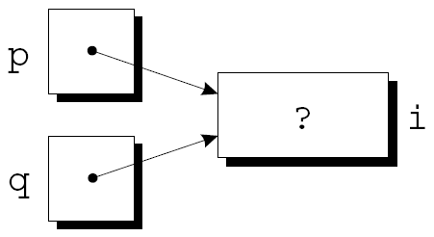
Pointer Assignment
C allows the use of the assignment operator to copy pointers of the same type.
int i;
int *p;
int *q;
p = &i;
q = p;
q now points to the same place as p.

Slide 4

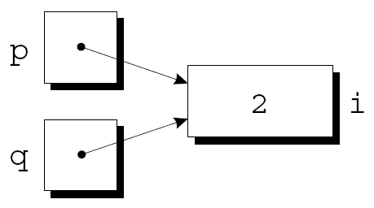
Pointer Assignment
If p and q both point to i, we can change i by assigning a new value to either *p or *q:
*p = 1;
*q = 2;

Slide 5
Pointer Assignment
Be careful not to confuse
q = p;
with
*q = *p;
The first statement is a pointer assignment, but the second is not.

Slide 6
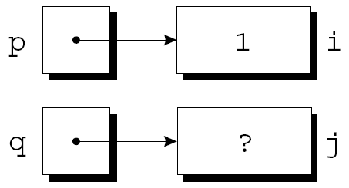
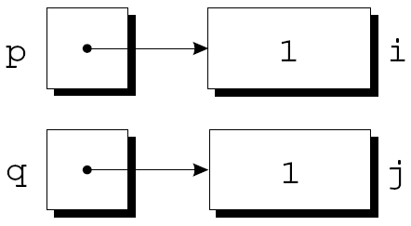
Pointer Assignment
int i, j;
int *p;
int *q;
p = &i;
q = &j;
i = 1;
*q = *p;

Slide 7
Pointers as Arguments

Slide 8
Pointers as Arguments
We have been using pointers as arguments since the beginning of the course.
Arguments in calls of scanf are pointers:
int i;
…
scanf("%d", &i);
8

Slide 9
Arguments: decompose function revisit
Suppose that we need a function that will decompose a double value into an integer part and a fractional part.
Since a function can’t return two numbers, we might try passing a pair of variables to the function and having it modify them:
void decompose(double x, int int_part,
double frac_part)
{
int_part = (int) x;
frac_part = x - int_part;
}
9

Slide 10
Arguments
A call of the function:
decompose(3.14159, i, d);
Unfortunately, i and d won’t be affected by the assignments to int_part and frac_part.
By passing a pointer to a variable instead of the value of the variable, decompose can be fixed.
10

Slide 11
Pointers as Arguments
New definition of decompose using pointers as arguments:
void decompose(double x, int *int_part,
double *frac_part)
{
*int_part = (int) x;
*frac_part = x - *int_part;
}

Slide 12
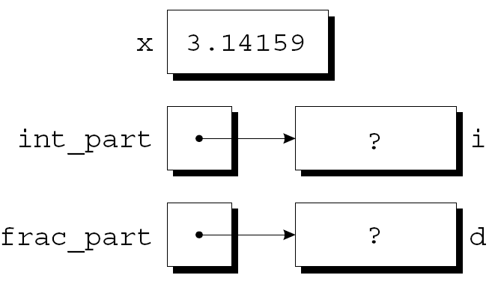
Pointers as Arguments
A call of decompose:
decompose(3.14159, &i, &d);
As a result of the call, int_part points to i and frac_part points to d:
void decompose(double x, int *int_part, double *frac_part)
{
*int_part = (int) x;
*frac_part = x - *int_part;
}

Slide 13
Exercise
What are the values of x and y after calling swap(x, y) with the swap function defined as follows? Assume int x = 3, y = 4;
void swap (int a, int b) {
int temp = a;
a = b;
b = temp;
}
3 4
4 3
3 3
4 4

Slide 14
Exercise
What are the values of x and y after calling swap(&x, &y) with the swap function defined as follows? Assume int x = 3, y = 4;
void swap (int *a, int *b) {
int temp = *a;
*a = *b;
*b = temp;
}
3 4
4 3
3 3
4 4

Slide 15
Example Program
Find the largest and smallest elements in an array with one function

Slide 16
Pointers as Return Values
Functions are allowed to return pointers:
int *max(int *a, int *b)
{
if (*a > *b)
return a;
else
return b;
}

Slide 17
Pointers as Return Values
A call of the max function:
int *p;
int i = 4;
int j = 9;
p = max(&i, &j);
After the call, p points to either i or j.

Slide 18
Pointers as Return Values
Never return a pointer to a local variable (automatic storage duration):
int *f(void)
{
int i;
…
return &i;
}
The variable i won’t exist after f returns.
18

Slide 19
Pointers: Array Elements
Pointers can point to array elements.
If a is an array, then &a[i] is a pointer to element i of a.
For example, a function that returns a pointer to the middle element of a, assuming that a has n elements:
int *find_middle(int a[], int n) {
return &a[n/2];
}
19

Slide 20
Example Program
Modify the find_largest program so that the find_largest function returns the pointer pointing to the largest element.

Slide 21
Programming Exercise
Write a find_two_largest function. When passed an array of length n, the function will search the array for its largest and second-largest elements, storing them in the variables pointed by largest and second_largest, respectively.
Prototype:
void find_two_largest(int a[], int n, int *largest, int *second_largest);

Slide 22
Exercise: main function
#define N 10
int main()
{
int i, max, second_max;
int a[N];
printf("Enter %d elements for the arary: ", N);
for(i=0;i<N;i++)
scanf("%d", &a[i]);
find_two_largest(a, N, &max, &second_max);
printf("the largest value is: %d and the second largest is: %d\n", max, second_max);
return 0;
}

